Slide 1
Praise the Lord

Slide 2
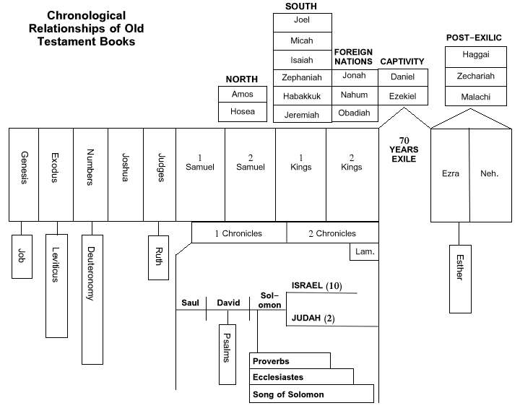

Slide 3
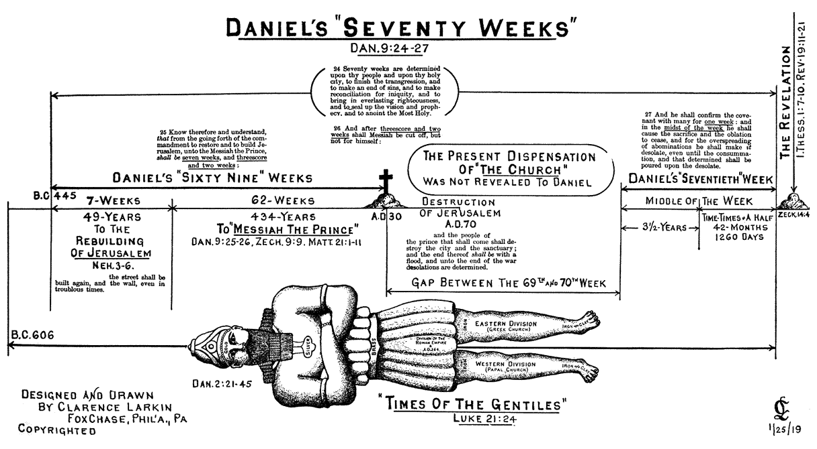

Slide 4
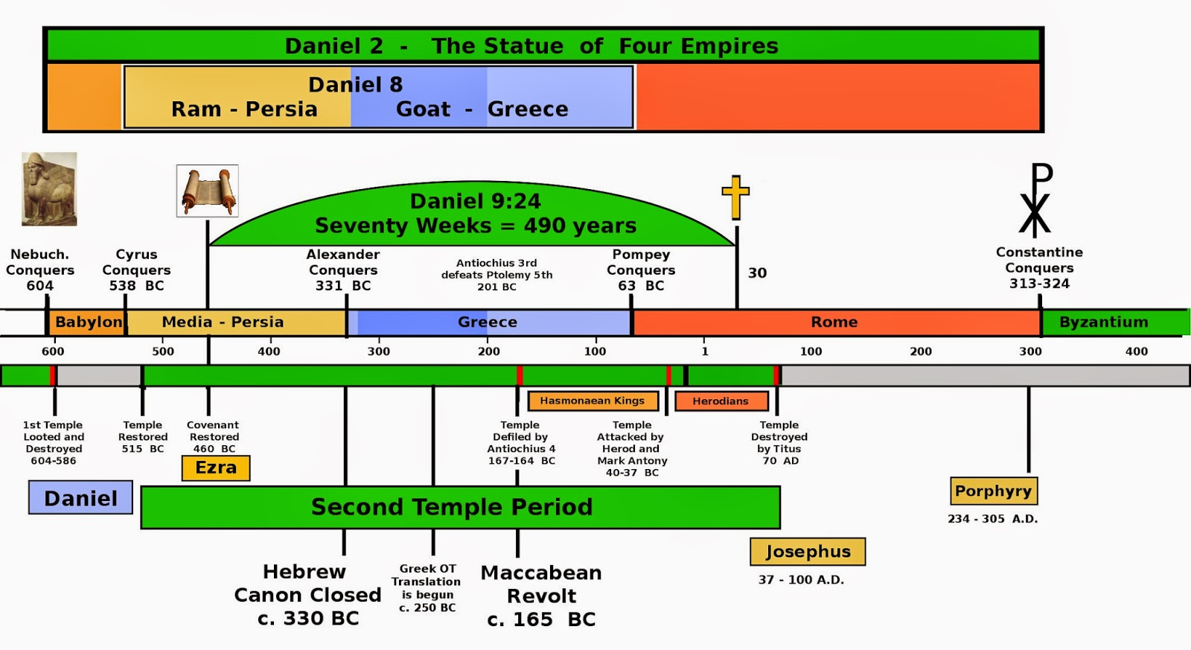

Slide 5
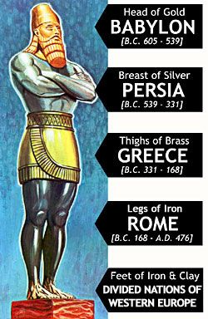

Slide 6
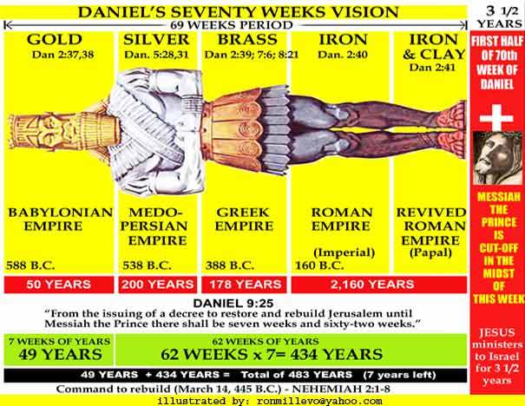

Slide 7
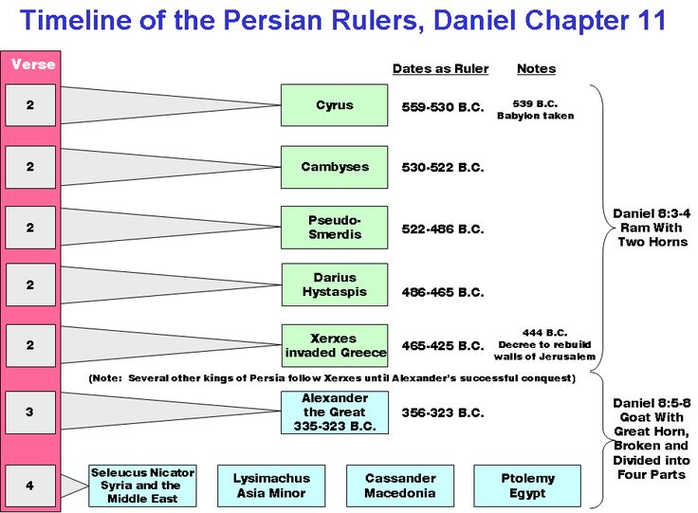

Slide 8
Book of Revelation

Slide 9
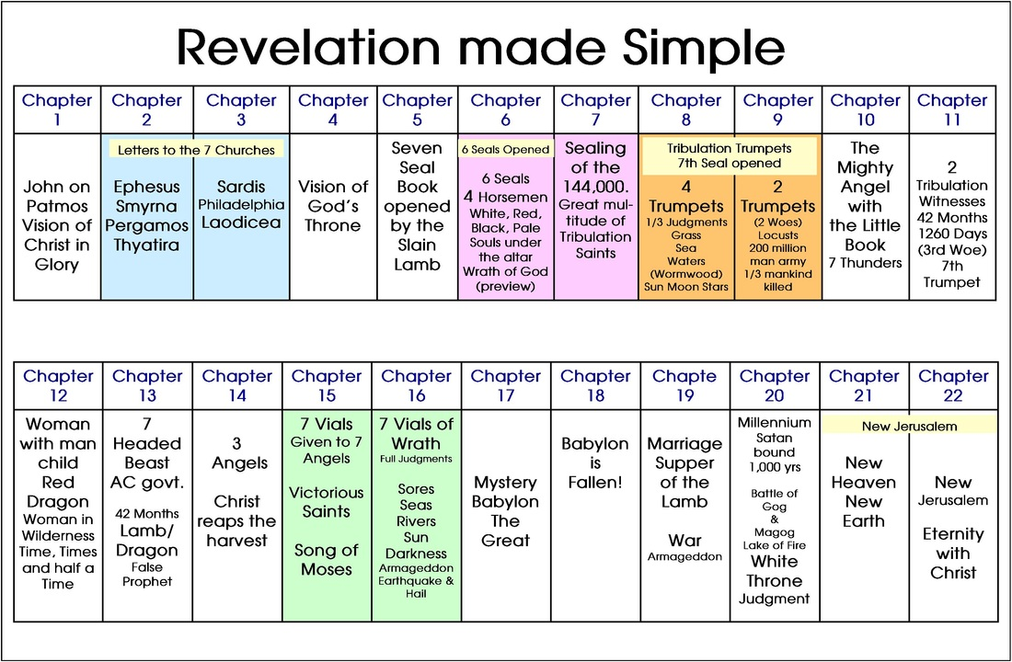

Slide 10
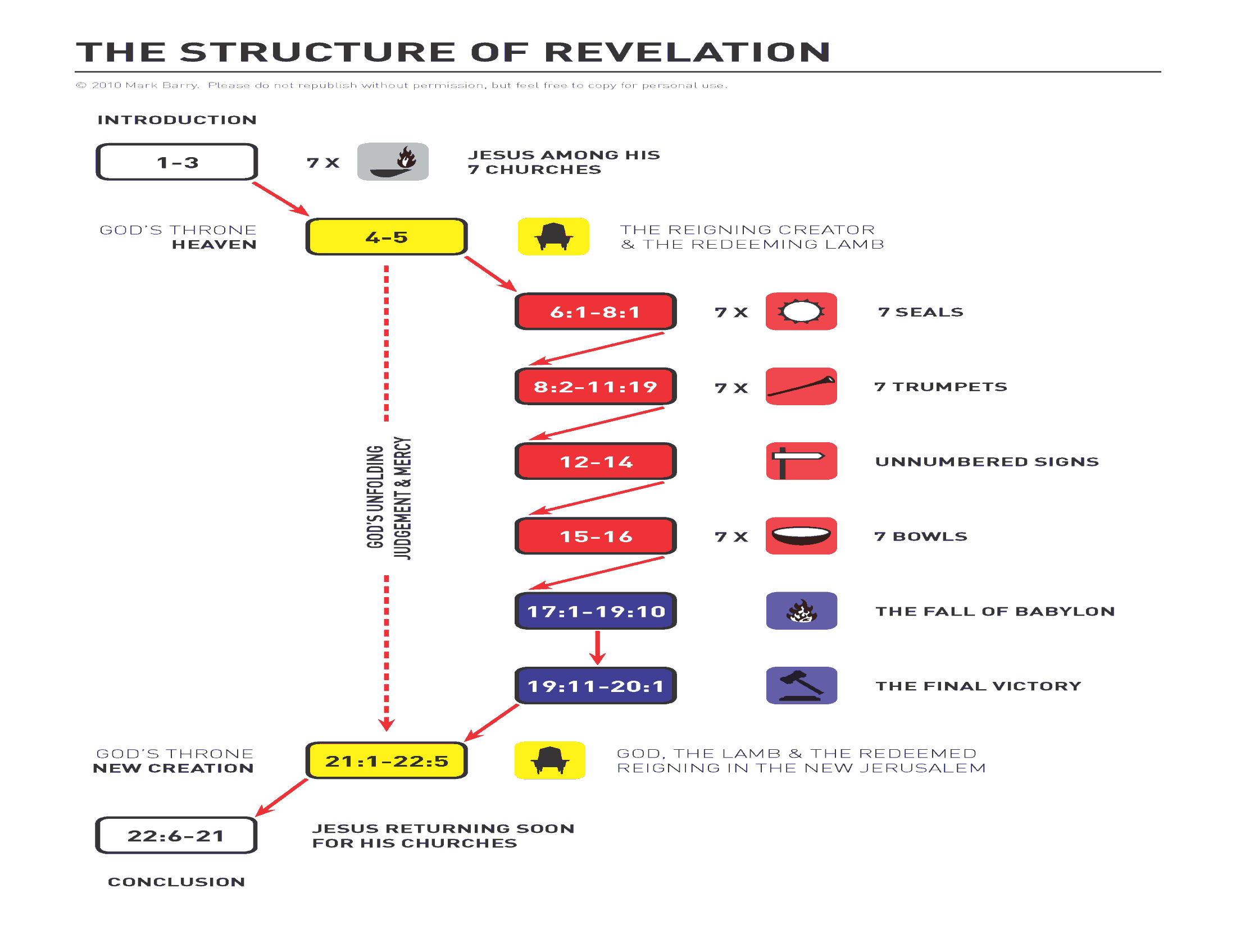

Slide 11
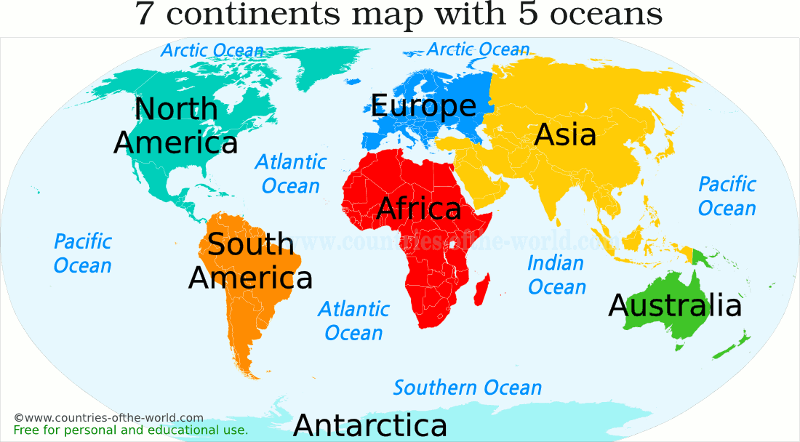

Slide 12
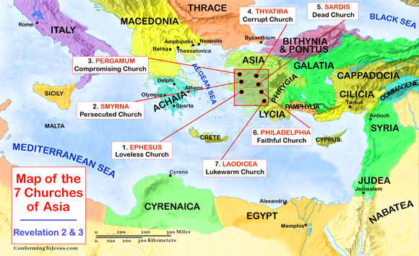

Slide 13
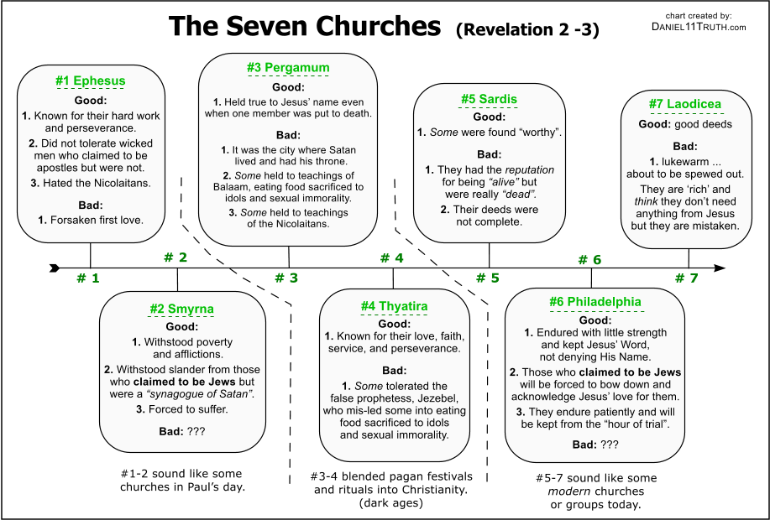

Slide 14
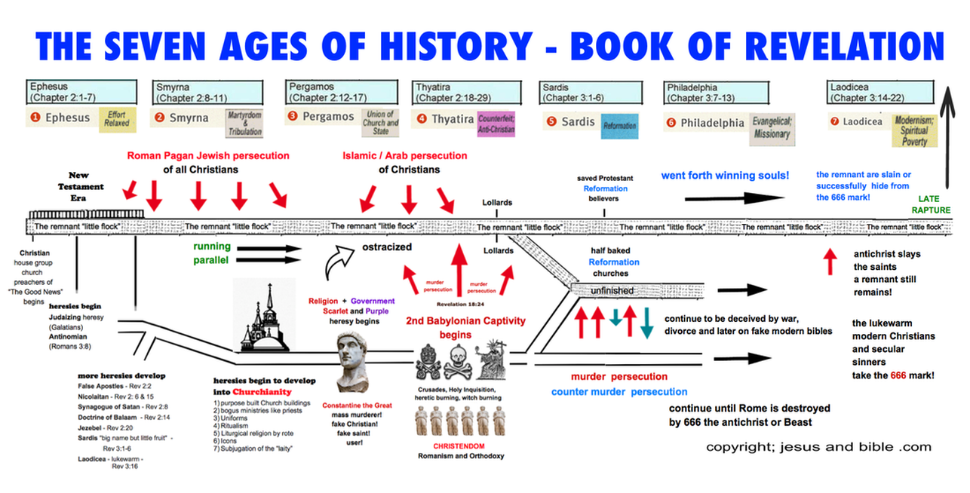

Slide 15
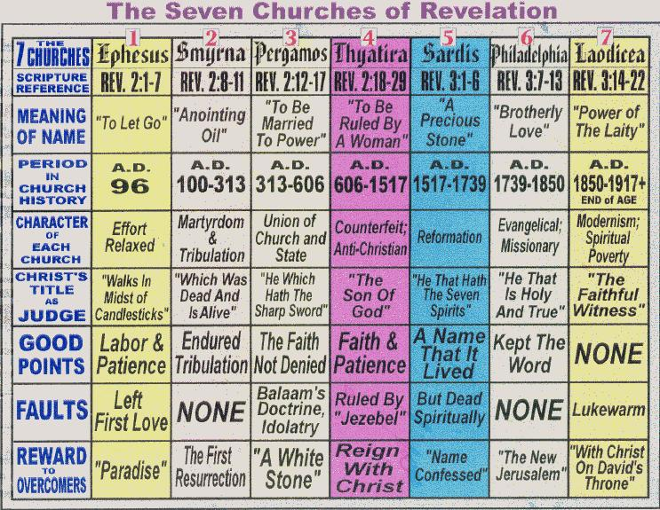

Slide 16
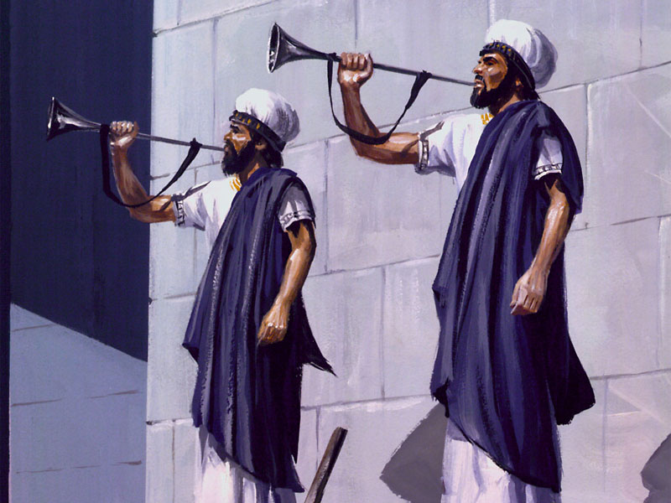
The 7 Trumpets
God’s Last Warnings to a Sinful Planet

Slide 17
Trumpets in Bible
OT use of trumpets
  War, warning, coronation, gathering a people
  Num. 10: 8-10 Temple services and holy wars
    Used by Priests – a reminder of God
NT Trumpets
  End time events
  Matt 24 God gather’s the elect
  1 Cor. 15 Resurrection to eternal life
  1 Thess. 4 Second coming of Christ

Slide 18
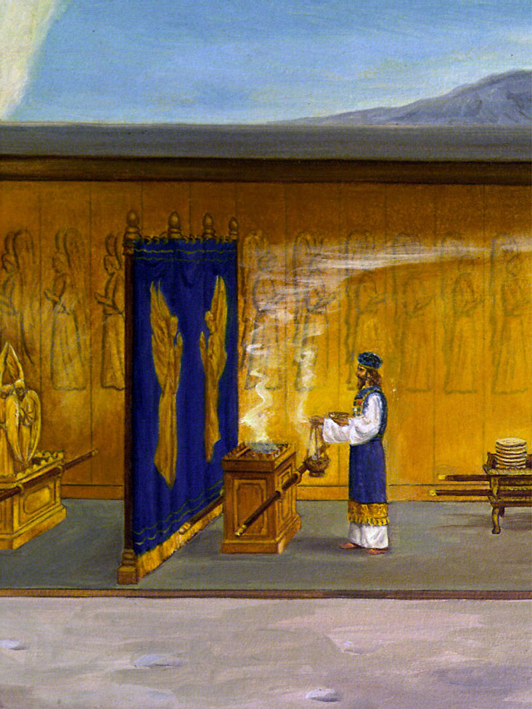
7 Trumpets
An angel before the altar of God sends thunder, lightning and earthquakes upon the earth (apparently) in answer to the prayer of the saints – then the angels can sound the 7 trumpets

Slide 19
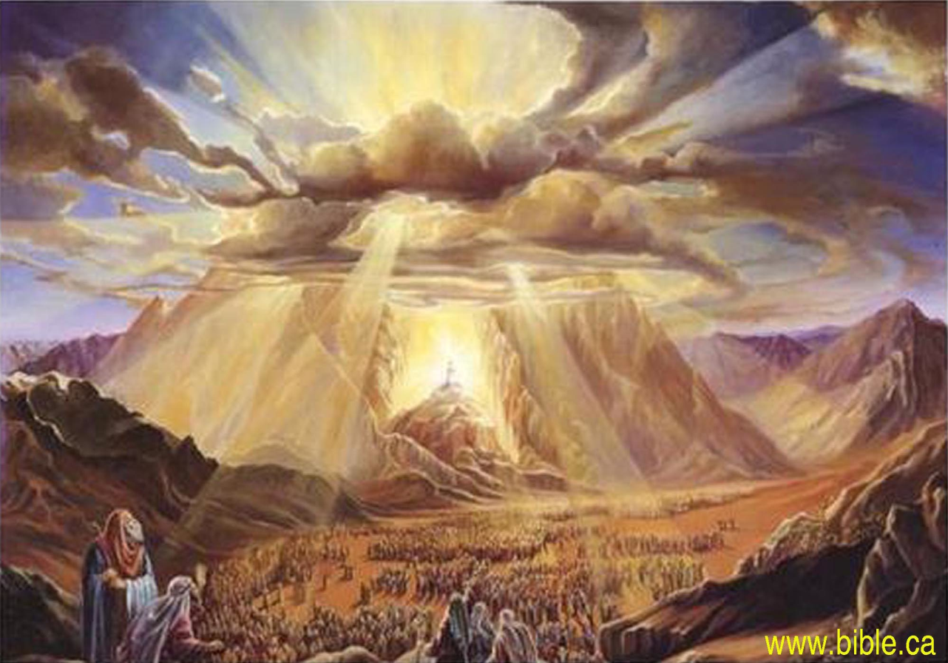
The Law of God
Thunder, lightning, earthquakes
Ex. 20:18

Slide 20
The Tamid
  Tamid is the daily service
    Altar of incense-prayers of the people
    Priest pours hot coals from the censer onto the altar of incense
    7 priests blow trumpets

Slide 21
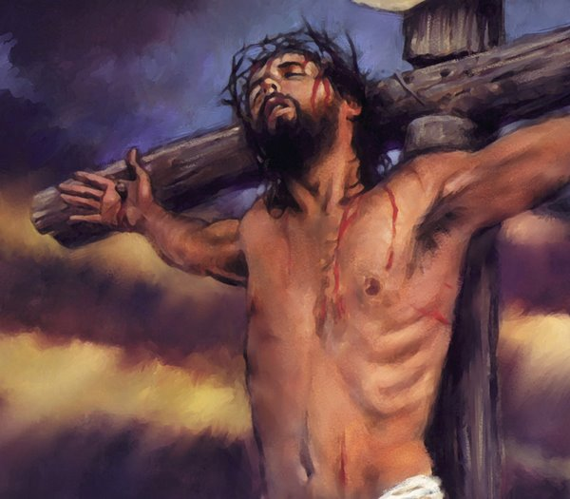
When are the Trumpets
Begin with the cross and end at the Second Coming
8:1 – 11:15

Slide 22
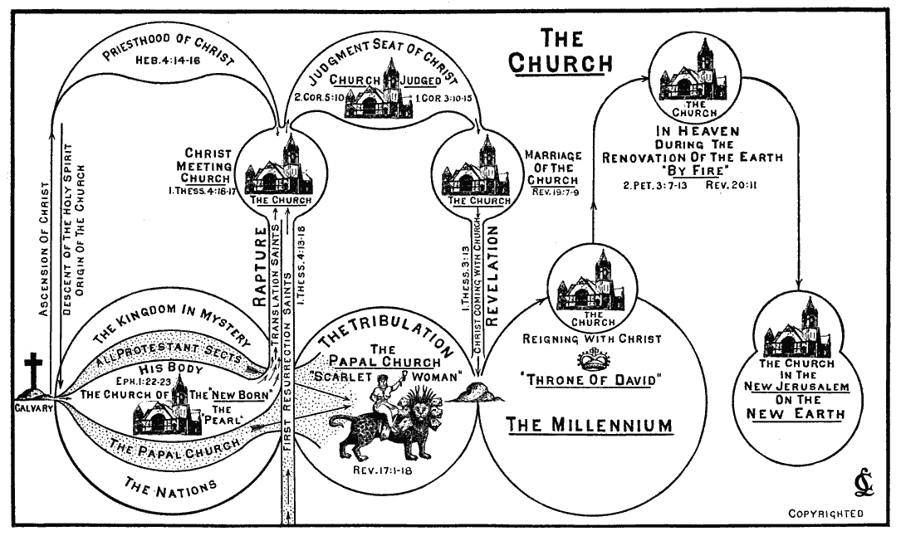

Slide 23
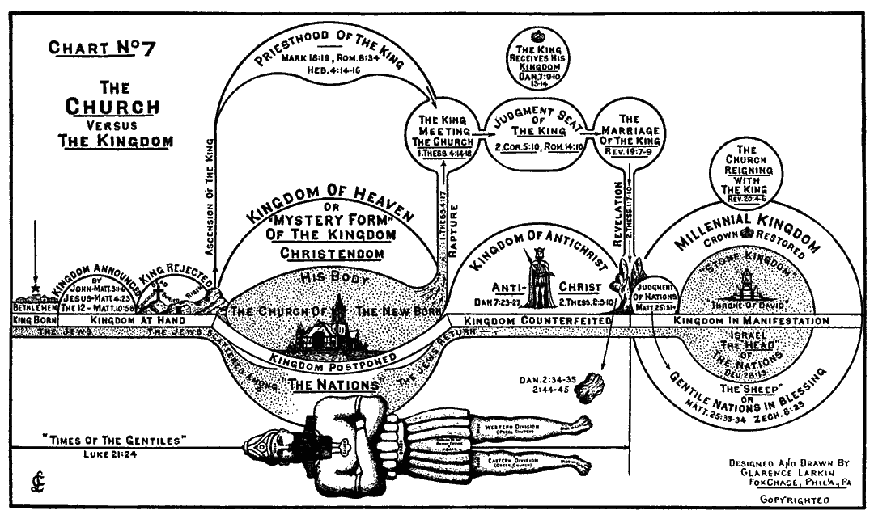

Slide 24
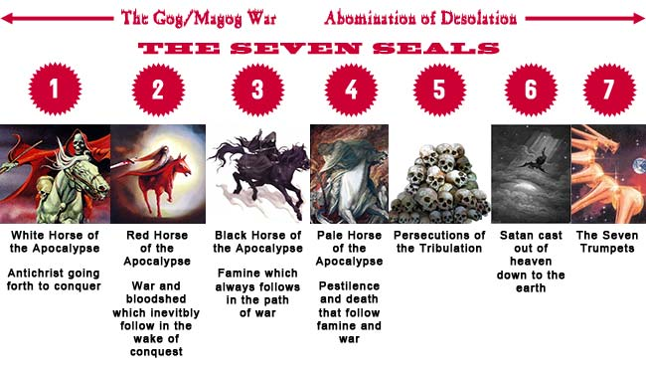

Slide 25
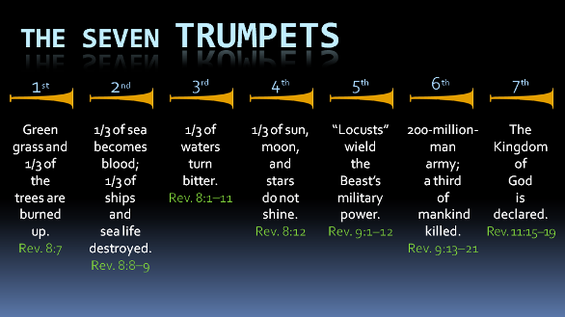

Slide 26
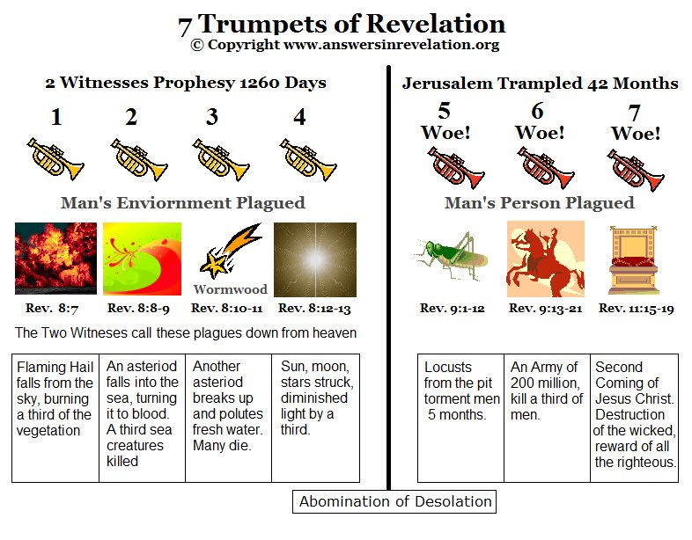

Slide 27
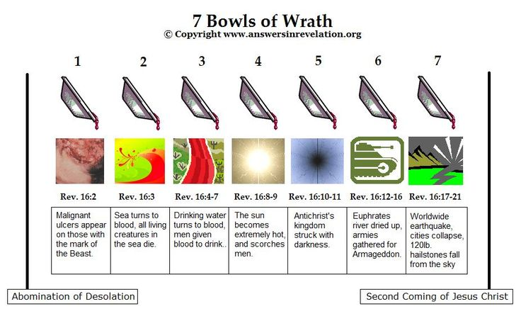

Slide 28
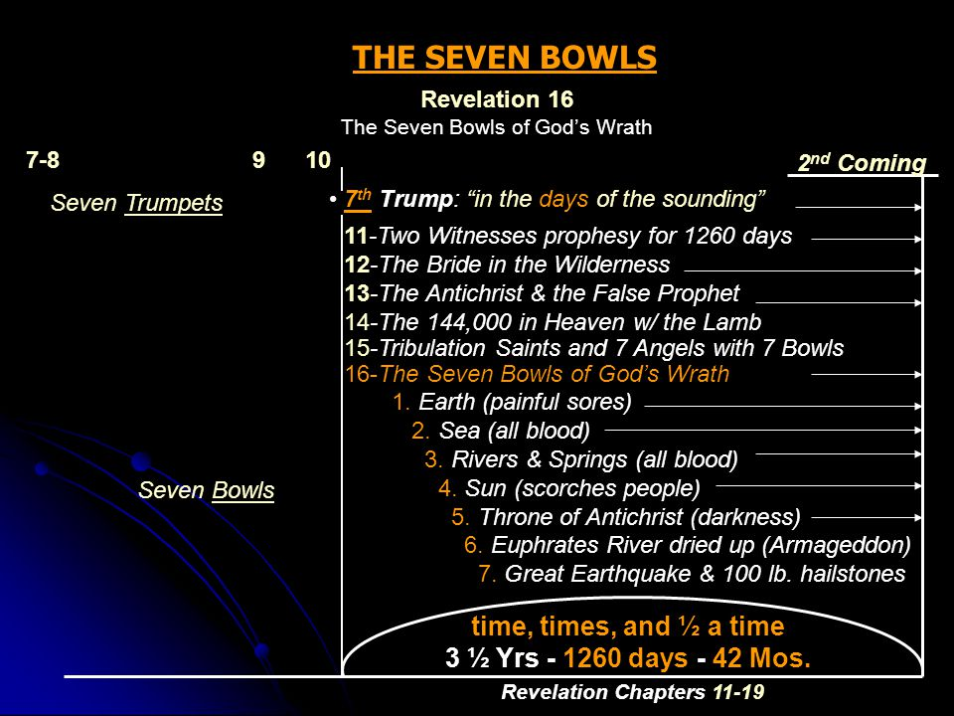

Slide 29
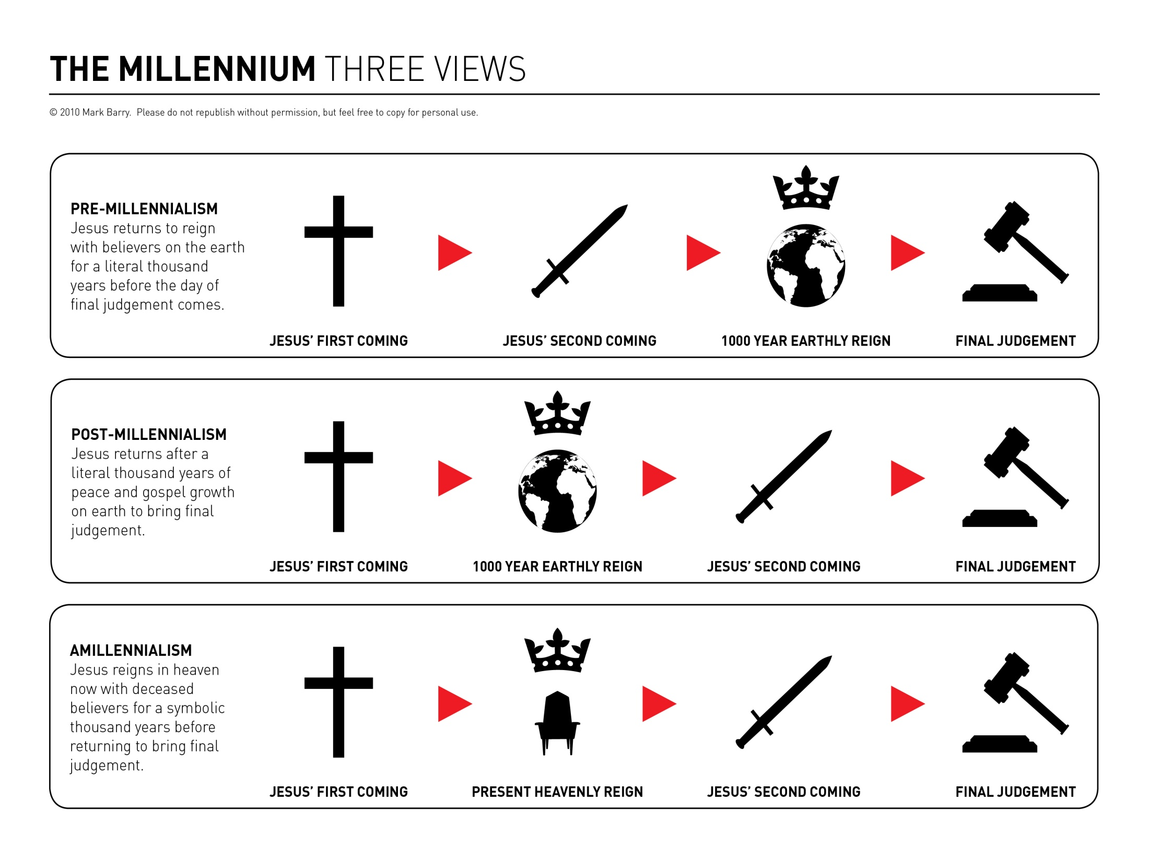
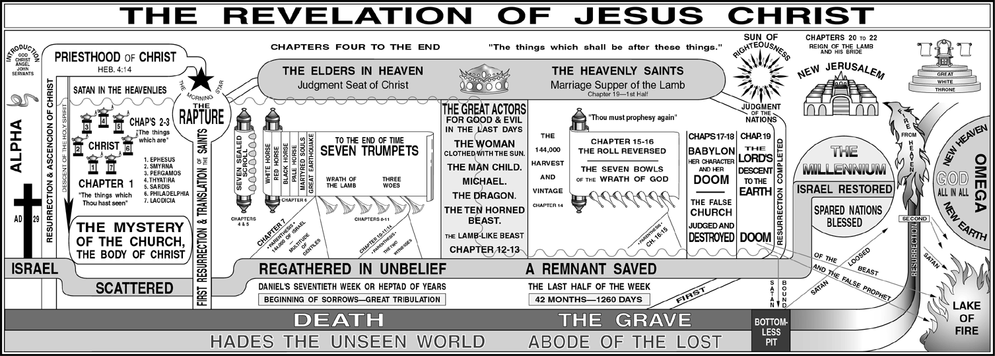

Slide 30
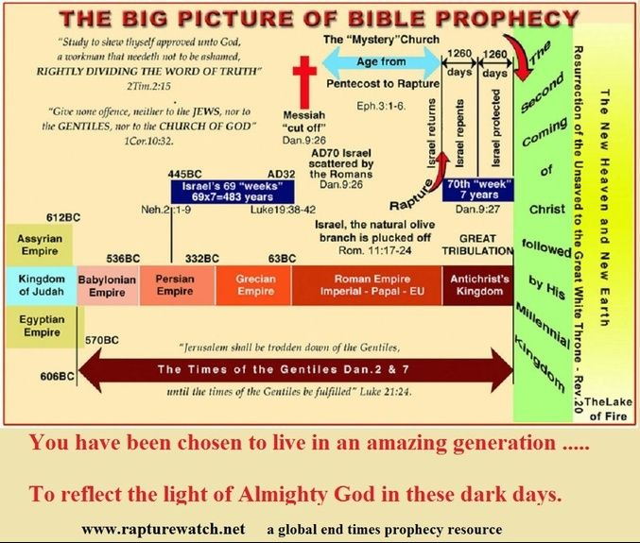

Slide 31
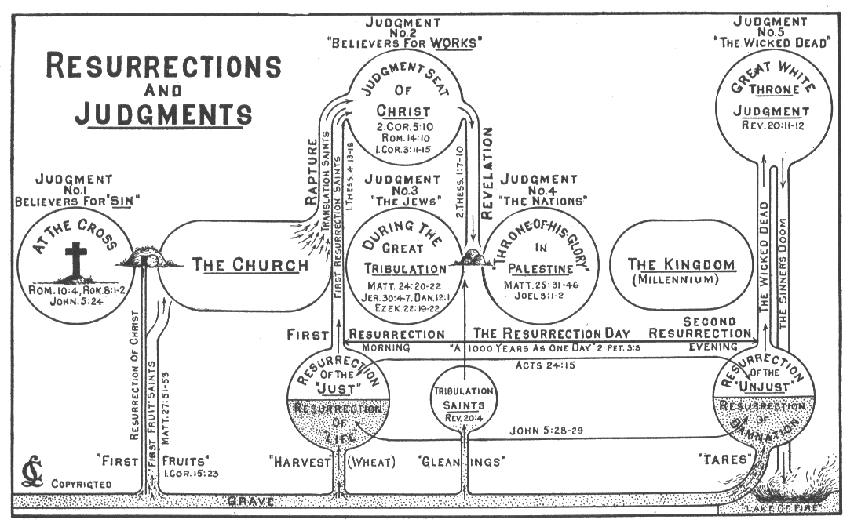

Slide 32
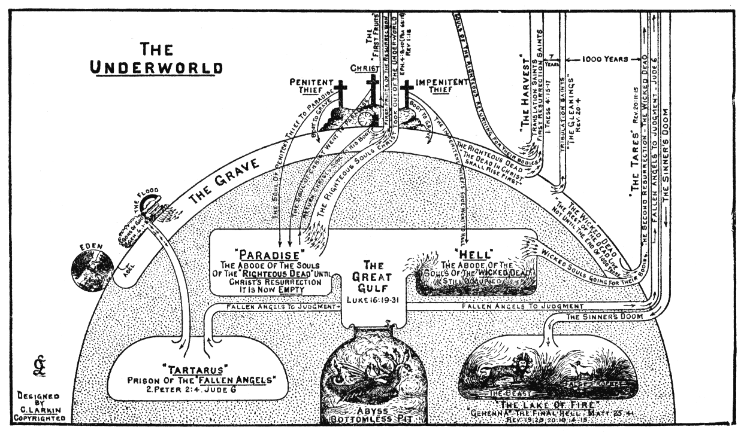

Slide 33
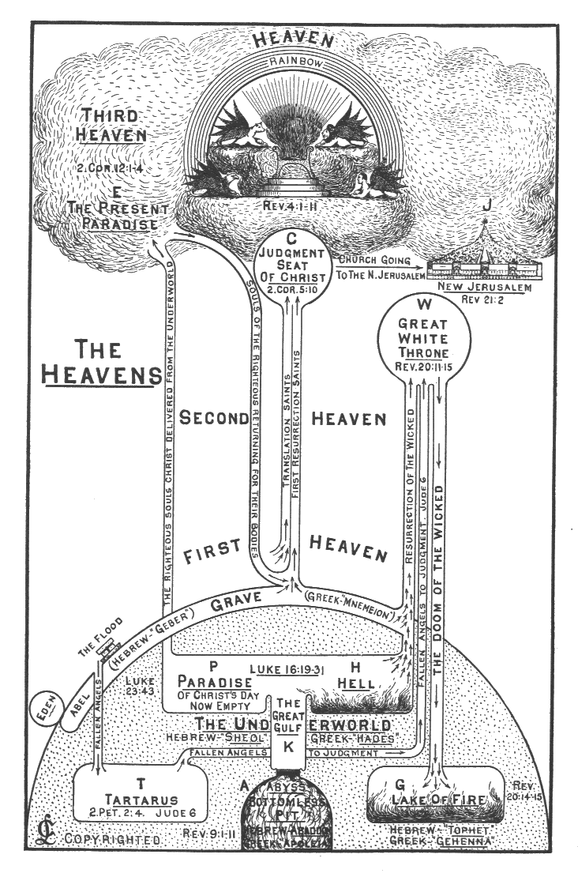

Slide 34
